Slide 1
HTML & CSS
Project

Slide 2
Personal Portfolio Webpage
You need to create a one-page personal portfolio that includes the following sections:
Header with your name and a navigation menu.
About Me section with a short bio and a photo.
Skills section listing your skills.
Projects section showcasing some of your work.
Contact section with a simple contact form.

Slide 3
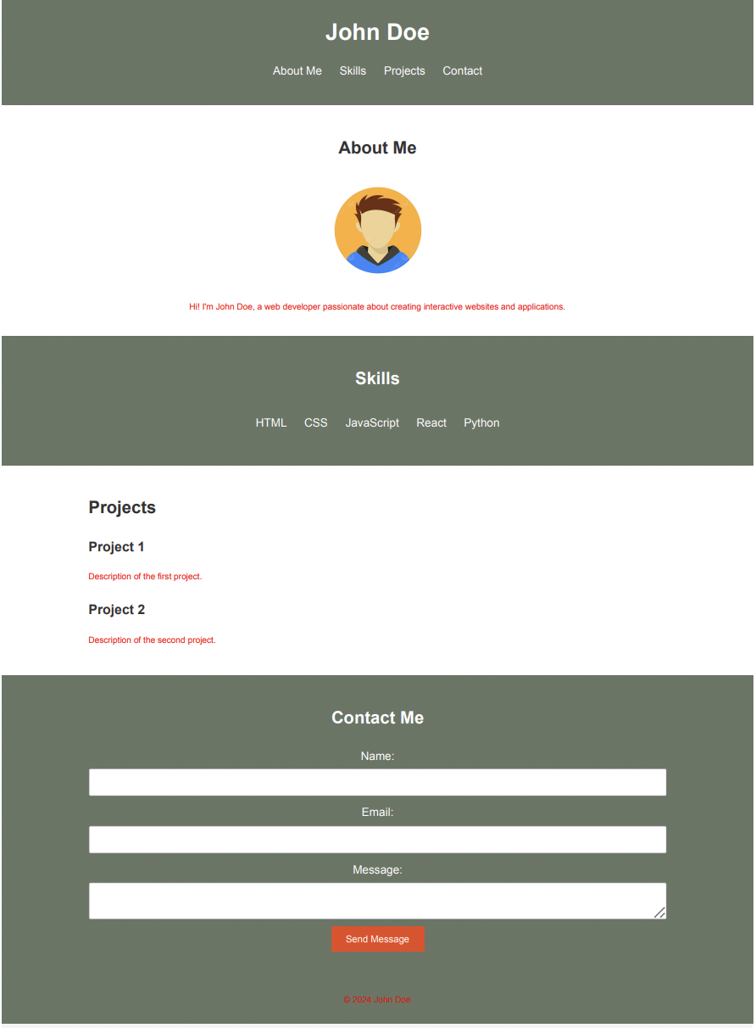
Example

